Slide 1
Checkpoint meeting ADS Thesis
Rick ten Eikelder

Slide 2
Progress Overview
Emulate full simulation based on initial state.
(finished)
Add time dependent drivers
(finished , not optimised)
Simulate on 4 different temperature corrections (TempLapseRate)
Emulate based on unseen temperature corrections
(finished, optimisation in process)
Multivariable prediction
(Not started)

Slide 3
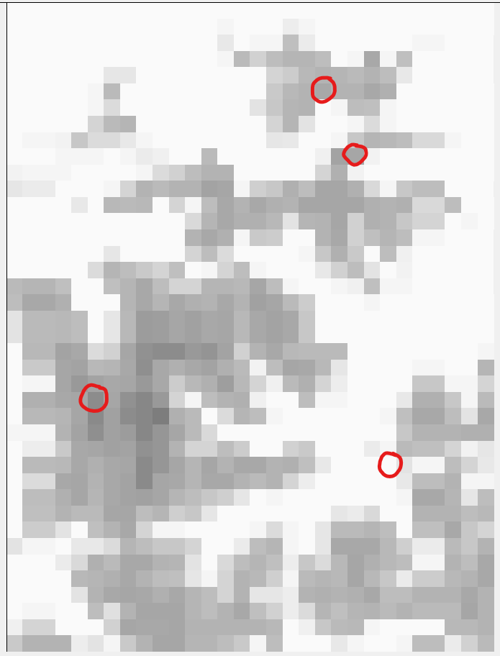
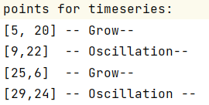
Points of evaluation
Column
6
20
22
24
Row
5
9
25
29

Slide 4
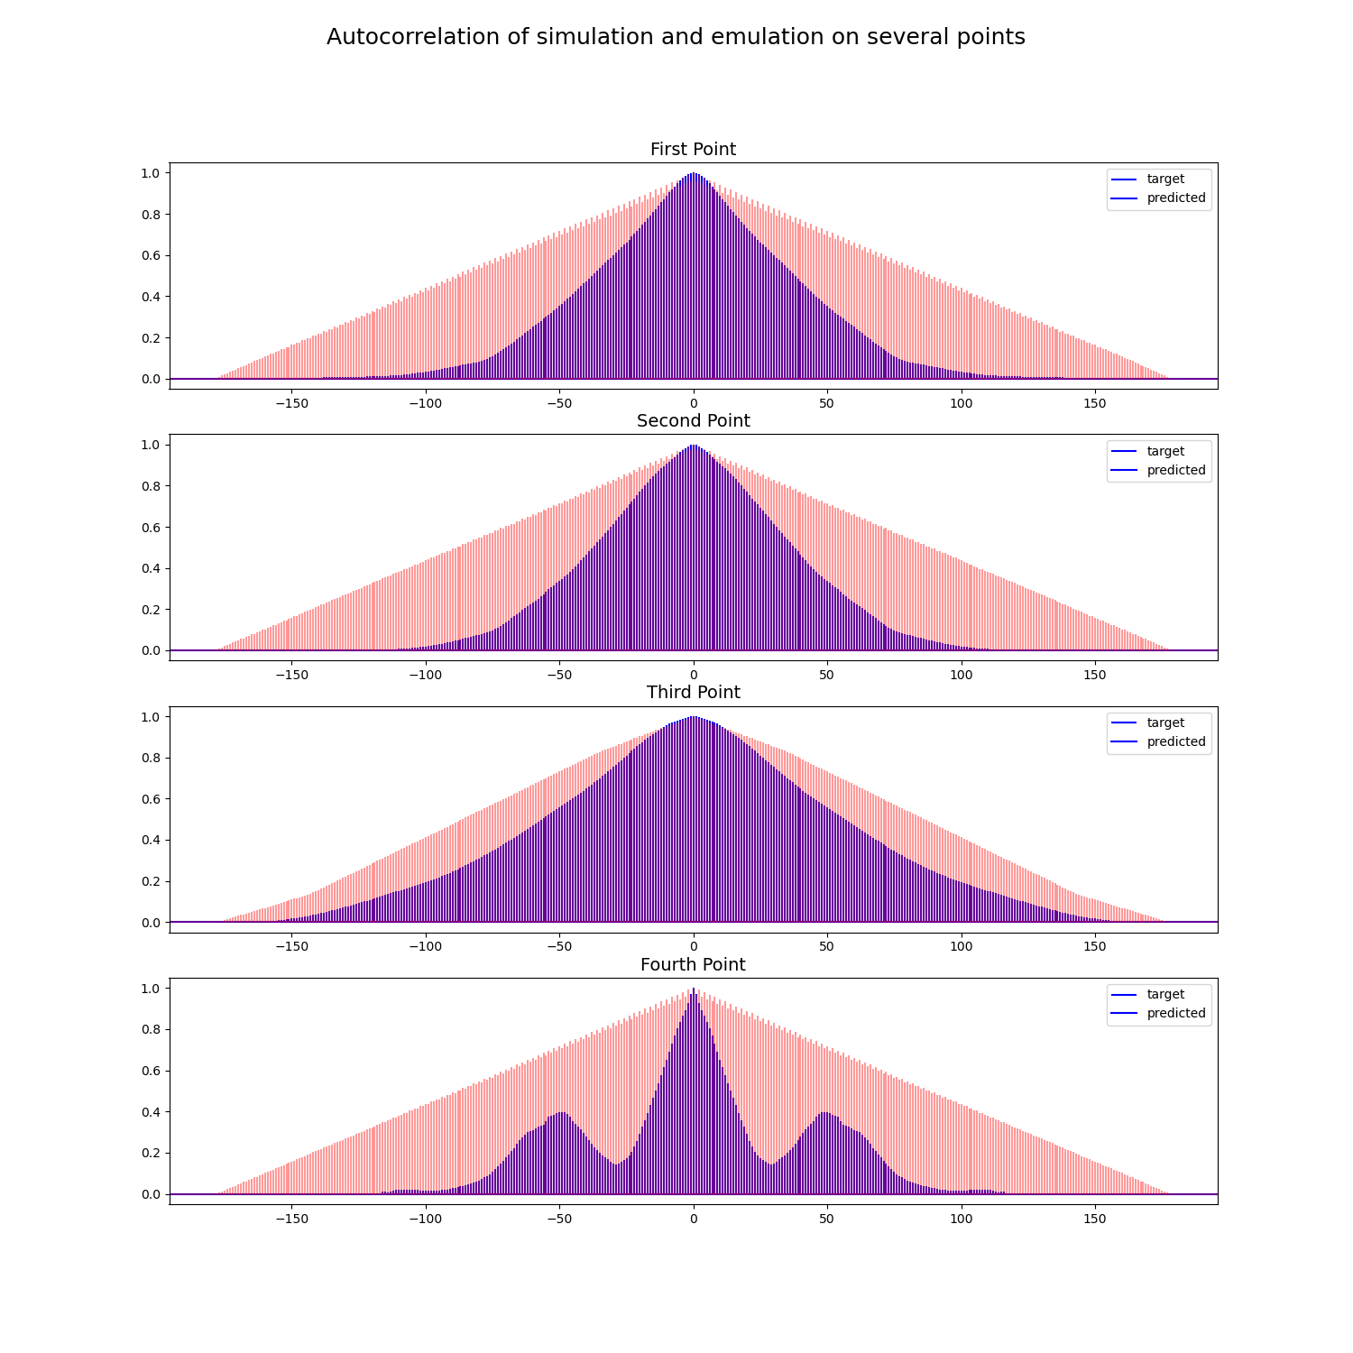
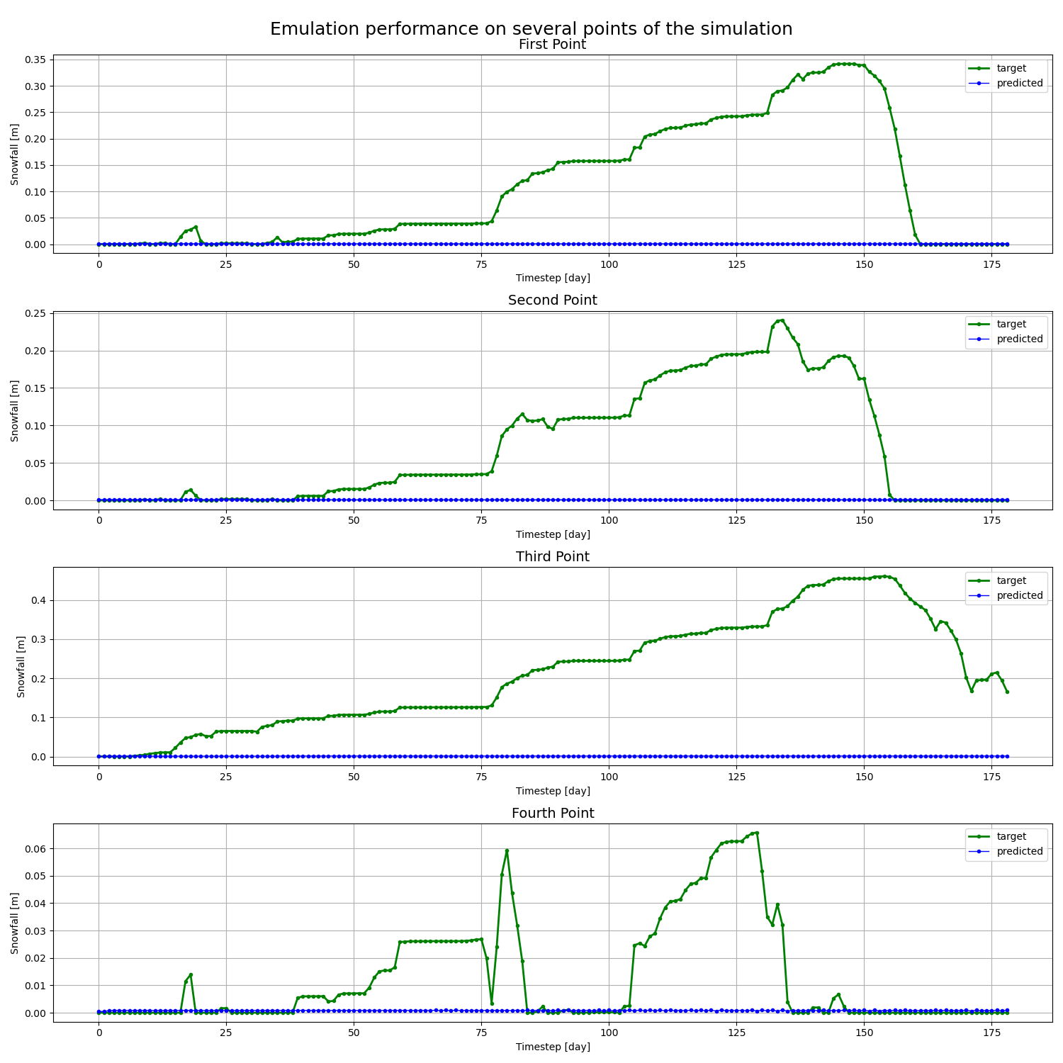
Emulate full simulation solely initial state

Slide 5
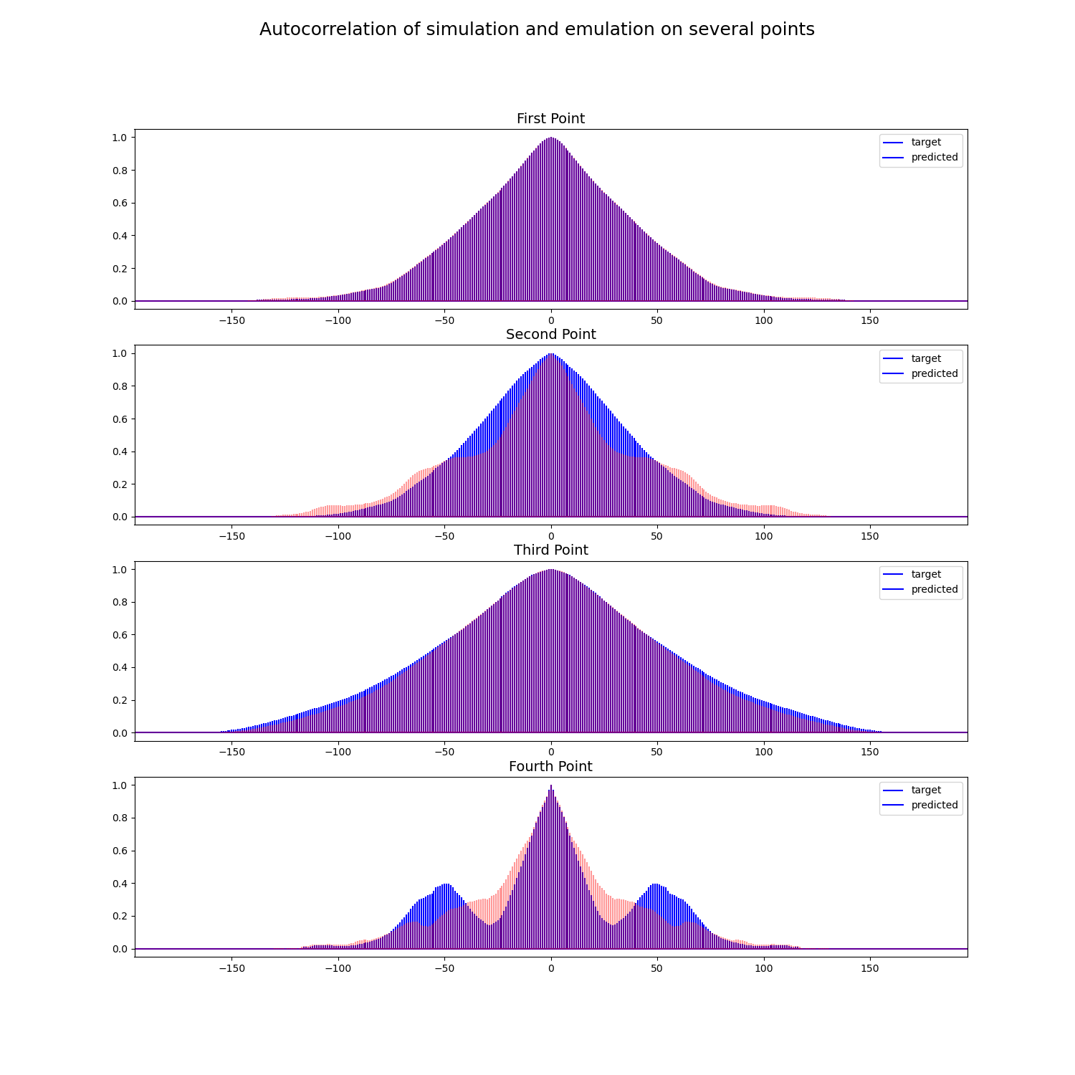
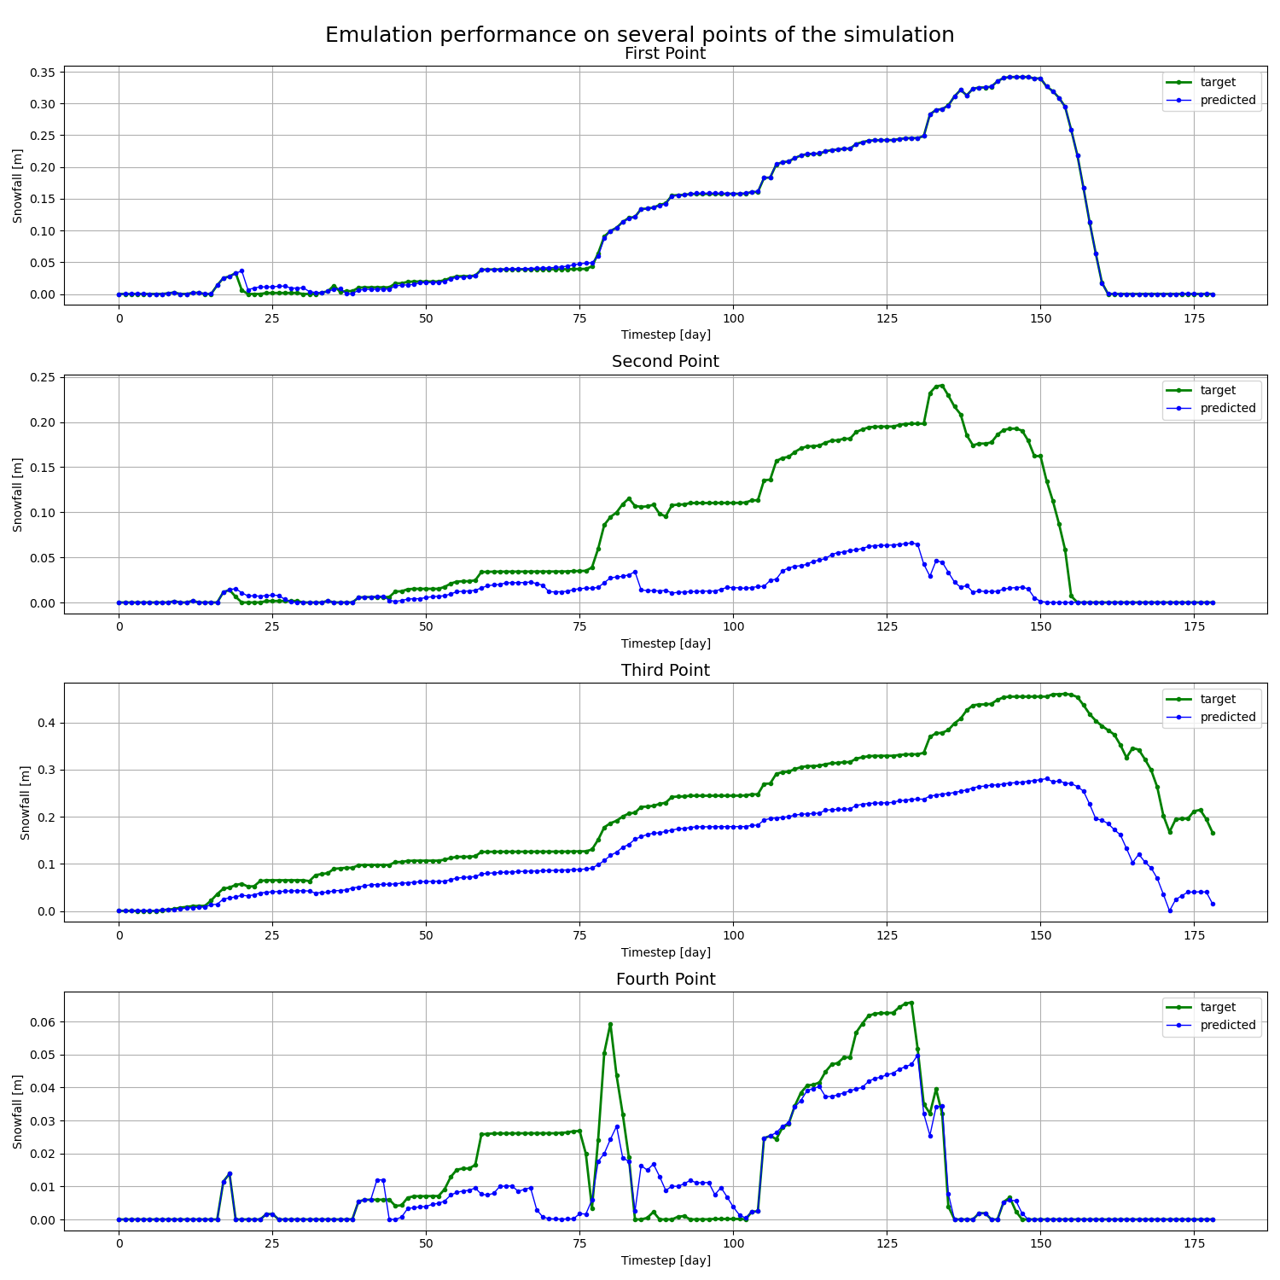
Emulate full simulation including time dependent drivers

Slide 6
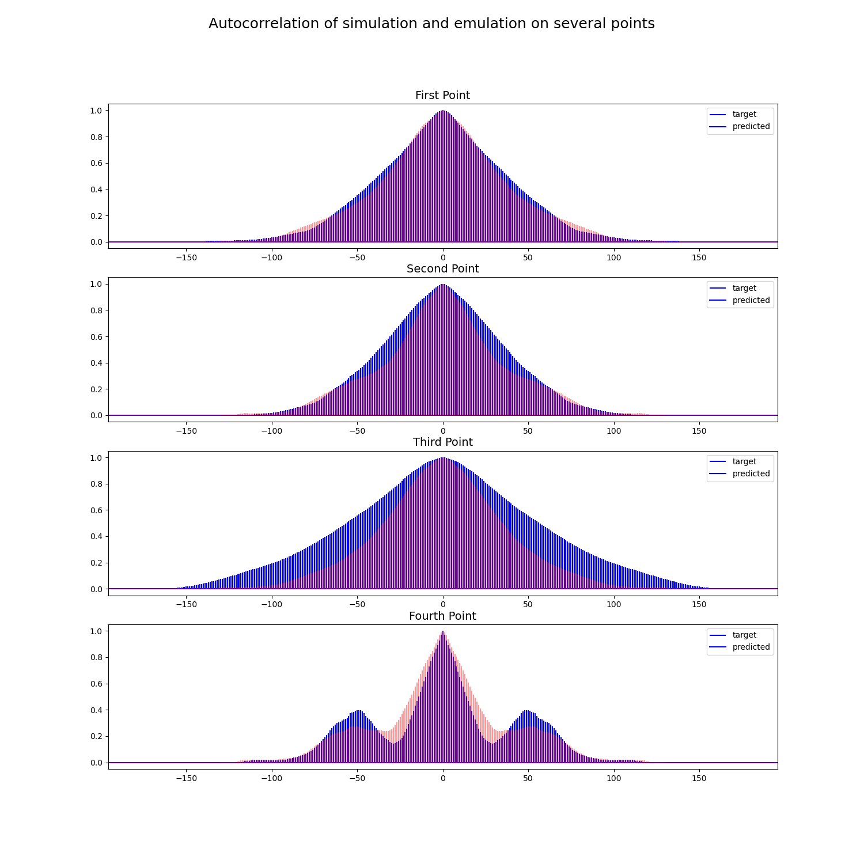
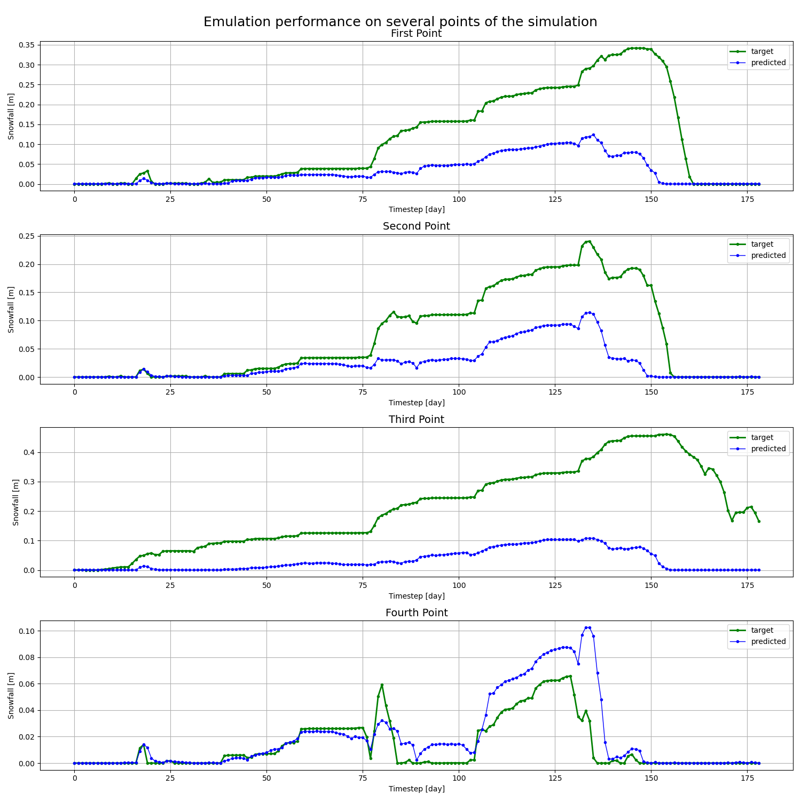
Emulate unseen temperature correction

Slide 7
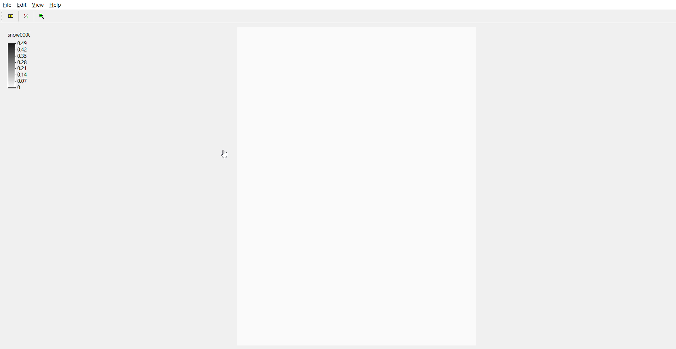
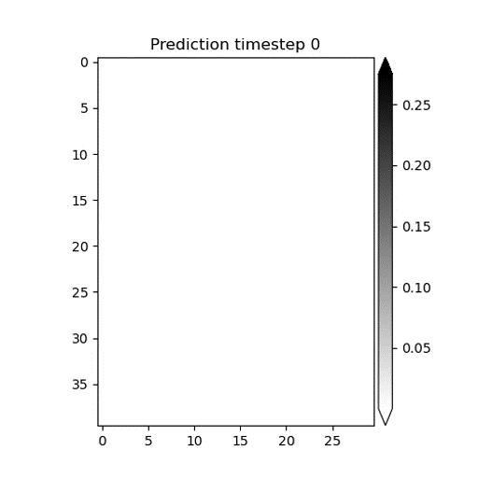
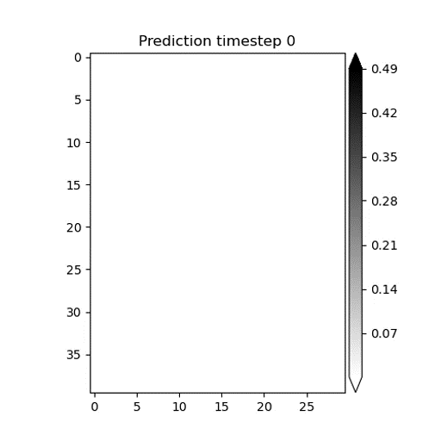

Compare Animated Emulations
Drivers and unseen
temperature corrections
No drivers
Drivers added
Target - Original simulation

Slide 8
Progress Overview
What’s next?
Optimise hyper parameters (runs a few days, I can write meanwhile)
Time and compare
Multivariable predictions (last extension of research due to time)
Write report

